Slide 1
Chapter 13 Section B

Slide 2
Mass Society

Slide 3
Mass Society
By 1850 there were more people living in cities

Slide 4
Mass Society
By 1850 there were more people living in cities
Urban dwellers is what these people became known as

Slide 5
Mass Society
By 1850 there were more people living in cities
Urban dwellers is what these people became known as
Urban dwellers – are simply people who live in an urban area

Slide 6
Mass Society
By 1850 there were more people living in cities
Urban dwellers is what these people became known as
Urban dwellers – are simply people who live in an urban area
The city government created a board of health to improve aspects of the city

Slide 7
Mass Society
The Board of Health improved housing, running water, and a drainage system was developed

Slide 8
Social Structure

Slide 9
Social Structure
Social Structure after 1871

Slide 10
Social Structure
Social Structure after 1871
New Elite – 5% of the population, this was industrialist, bankers, and merchants

Slide 11
Social Structure
Social Structure after 1871
New Elite – 5% of the population, this was industrialist, bankers, and merchants
Middle Class – lawyers, doctors, architects, engineers, and shopkeepers

Slide 12
Social Structure
Social Structure after 1871
New Elite – 5% of the population, this was industrialist, bankers, and merchants
Middle Class – lawyers, doctors, architects, engineers, and shopkeepers
Working class – 80% of the population, peasants, sharecroppers, and laborer's

Slide 13
Women during Industrial Revolution

Slide 14
Women during Industrial Revolution
Shortage of male workers led to hiring women

Slide 15
Women during Industrial Revolution
Shortage of male workers led to hiring women
The number of children that were born during this time declined because of the economic conditions and birth control

Slide 16
Women during Industrial Revolution
Feminism – The movement for women's rights

Slide 17
Women during Industrial Revolution
Feminism – The movement for women's rights
Equality for women, fight for property rights, attend university, and political rights

Slide 18
Women during Industrial Revolution
Amalie Sieveking – founded the female association for the care of the poor and sick in Hamburg, Germany

Slide 19
Women during Industrial Revolution
Amalie Sieveking – founded the female association for the care of the poor and sick in Hamburg, Germany
Florence Nightingale – famous British nurse

Slide 20
Women during Industrial Revolution
Amalie Sieveking – founded the female association for the care of the poor and sick in Hamburg, Germany
Florence Nightingale – famous British nurse
Clara Barton – started the American Red Cross

Slide 21
Women during Industrial Revolution
Emmeline Pankhurst – used publicity stunts to bring attention to women's demands

Slide 22
Women during Industrial Revolution
Emmeline Pankhurst – used publicity stunts to bring attention to women's demands
Chained themselves to lamp post, smashed windows, threw eggs at officials

Slide 23
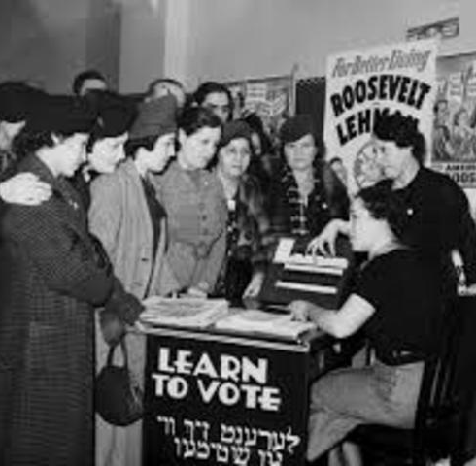
Voting

Slide 24
Voting
Suffrage – The right to vote

Slide 25
Voting
Suffrage – The right to vote
Suffragette – Women fighting for the right to vote

